Slide 1
PhD Interview Research Introduction
PhD Interview @ xx/xx/2023
Linzhan Mou
CKC Honors College @ Zhejiang University
3D Vision/Generative AI

Slide 2
Short Bio
Education
Major: Automation @ CKC Honors College
GPA: 3.98/4.0 , Ranking: top 3%
Minor: Advanced Honor Class of Engineering Education
Linzhan MOU(牟林湛)
Research Experience
State Key Laboratory of CAD&CG, ZJU
Advisor: Prof. Xiaowei ZHOU
Topic: 3D Vision/Graphics
YU-Lab, UIUC, USA
Advisor: Prof. Yuxiong WANG
Topic: Generative AI/3D Vision
APRIL-Lab, ZJU
Advisor: Prof. Yong LIU
Topic: Computer Vision/Generative AI
Honors & Awards
National Scholarship
First-Class Scholarship of Zhejiang University
Top 10 Outstanding Students of the Academy
Government Scholarship of Zhejiang Province
Supcon Technology Group Scholarship
National First Prize, CUMCM
International Gold Prize, IGEM
First Prize, Supcon Cup Robot Competition
Academic Excellence Scholarship of Zhejiang University

Slide 3
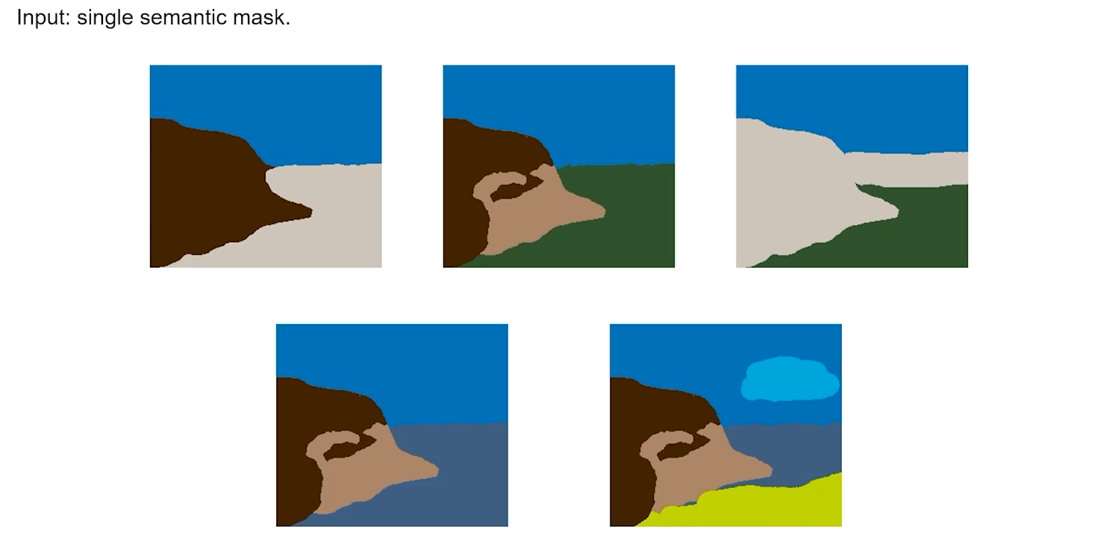
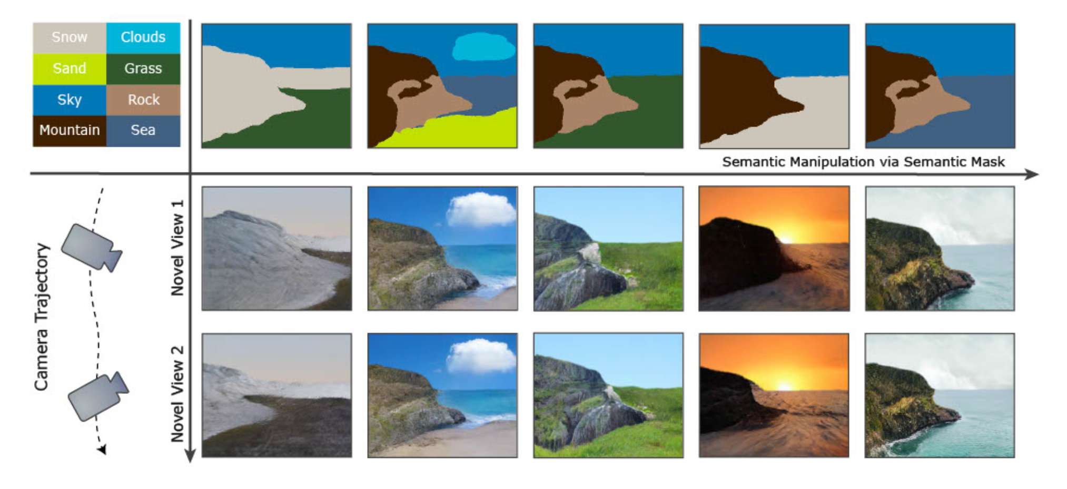
Painting 3D Nature in 2D (CVPR2023)
Task: takes a single semantic mask as input to synthesize multi-view consistent color images of natural scenes
Key idea: use a semantic field as the intermediate representation, which is easier to reconstruct from an input semantic mask and then translate to a radiance field with the assistance of off-the-shelf semantic image synthesis models.

Slide 4
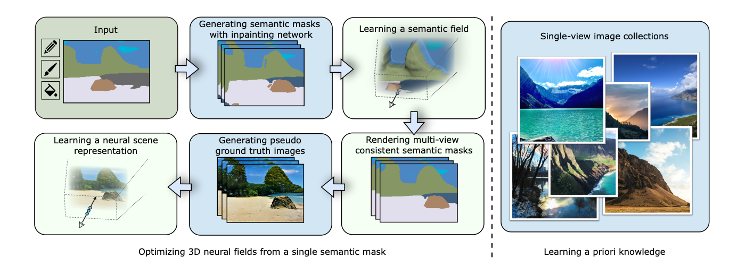
Our Pipeline and Methods
Generate multi-view semantic masks with an inpainting network and then convert semantic masks to RGB images using SPADE
learned with the supervision of multi-view 2D videos
Neural scene representation is optimized to fuse appearance information provided by SPADE, which enables view-consistent rendering

Slide 5
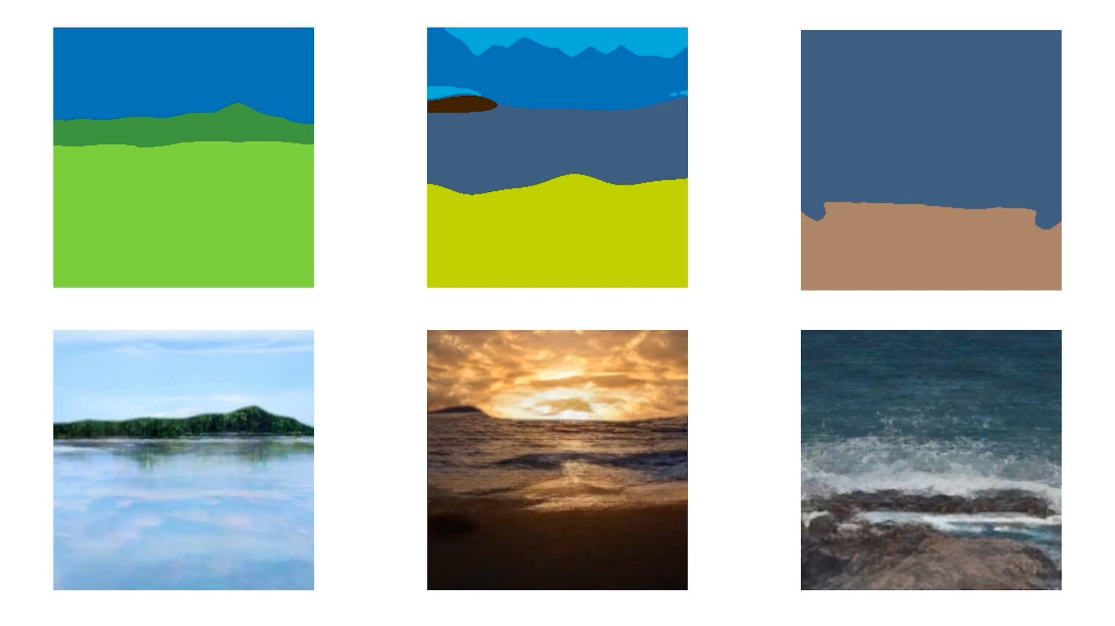
Experiment Results
Notes:
Editing the shape of a 3D scene, for example, Optimus Prime transforms between a humanoid and a truck, impacts many applications in computer vision.
The main challenge of this task is % to generate visual-faithful, natural results consistent with ambient environment.

Slide 6
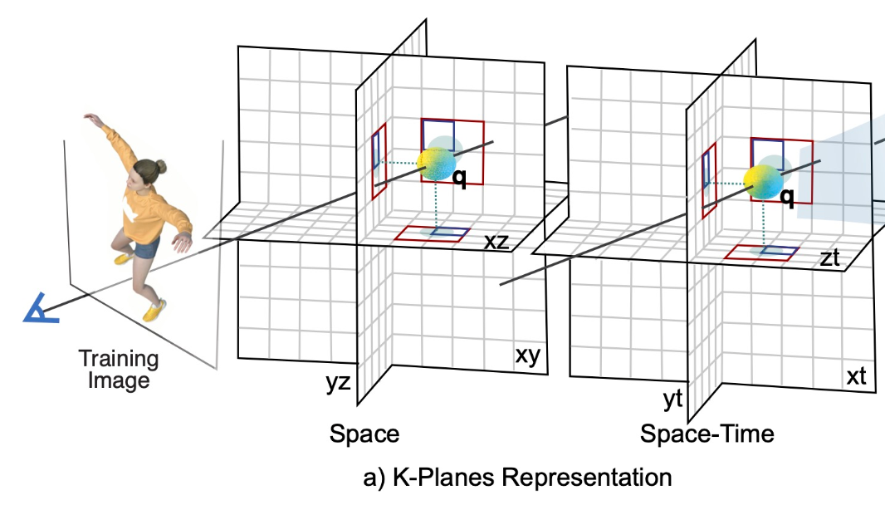
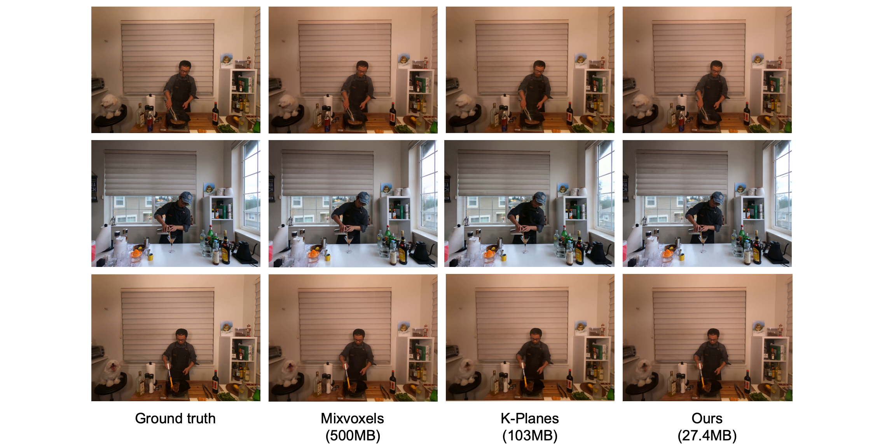
Volumetric Video Representations with Dynamic Codebooks (NeurIPS2023)
Task: high-fidelity volumetric videos with low storage cost
Key idea: novel neural representation —— dynamic codebook, which first merges similar features for the model compression and then compensates for the potential decline in rendering quality by a set of dynamic codes.

Slide 7
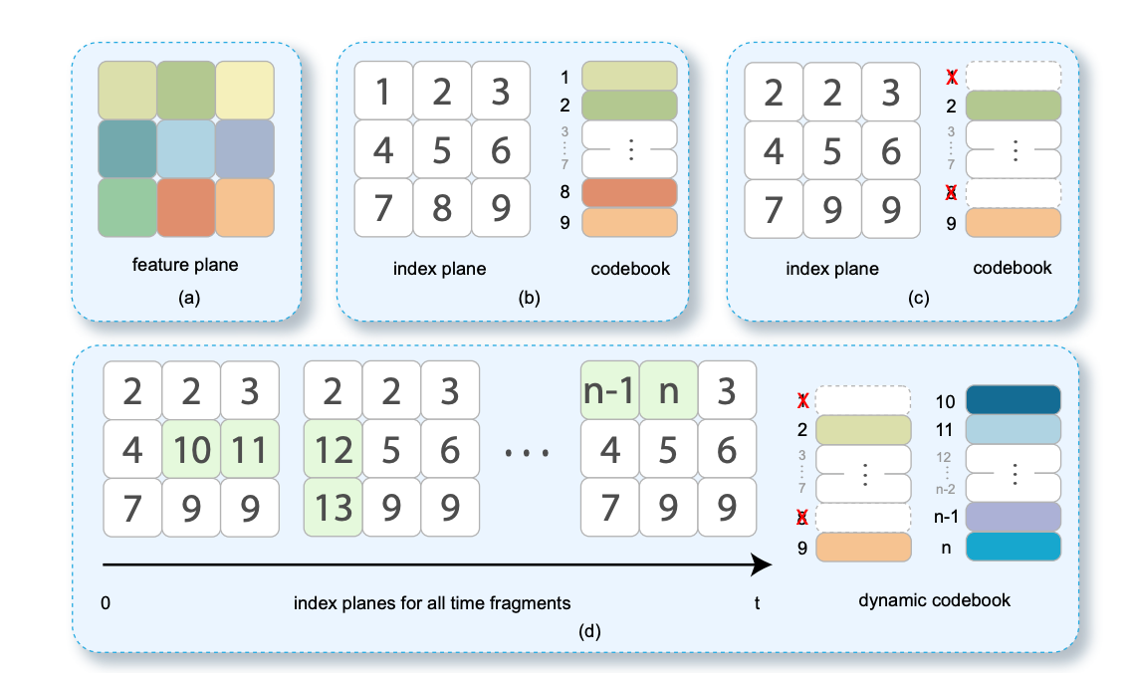
Our Pipeline and Methods
Model volumetric videos with multiple feature planes
learned with the supervision of multi-view 2D videos
Convert the feature planes to an index plane as well as a codebook
👍 the codebook is constructed by directly flattening of the feature plane
Use clustering method (K-means) to merge similar codes
Dynamic codes are appended to the trimmed codebook
maintain an index plane for each time fragment
optimize a portion of the codes for each time fragment. These codes are incrementally added to the codebook, and the corresponding positions in the index plane are updated

Slide 8
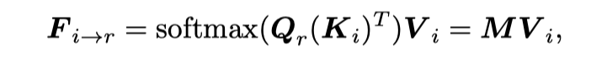
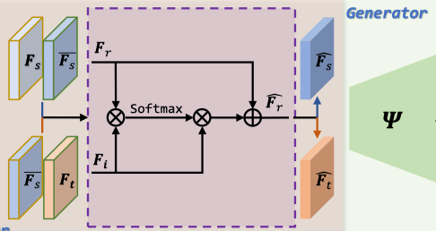
AttFace: High-resolution Face Swapping with Attention Network (TCI)
Class-Specific Attributes Transfer
To finely aggregate identity information between identity and reference faces, we propose a novel Identity Transfer module, which is well designed based on the self-attention mechanism.
Source Face
Feature map
Q
K
V
Target Face
Feature map

Slide 9
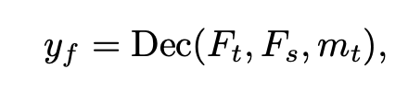
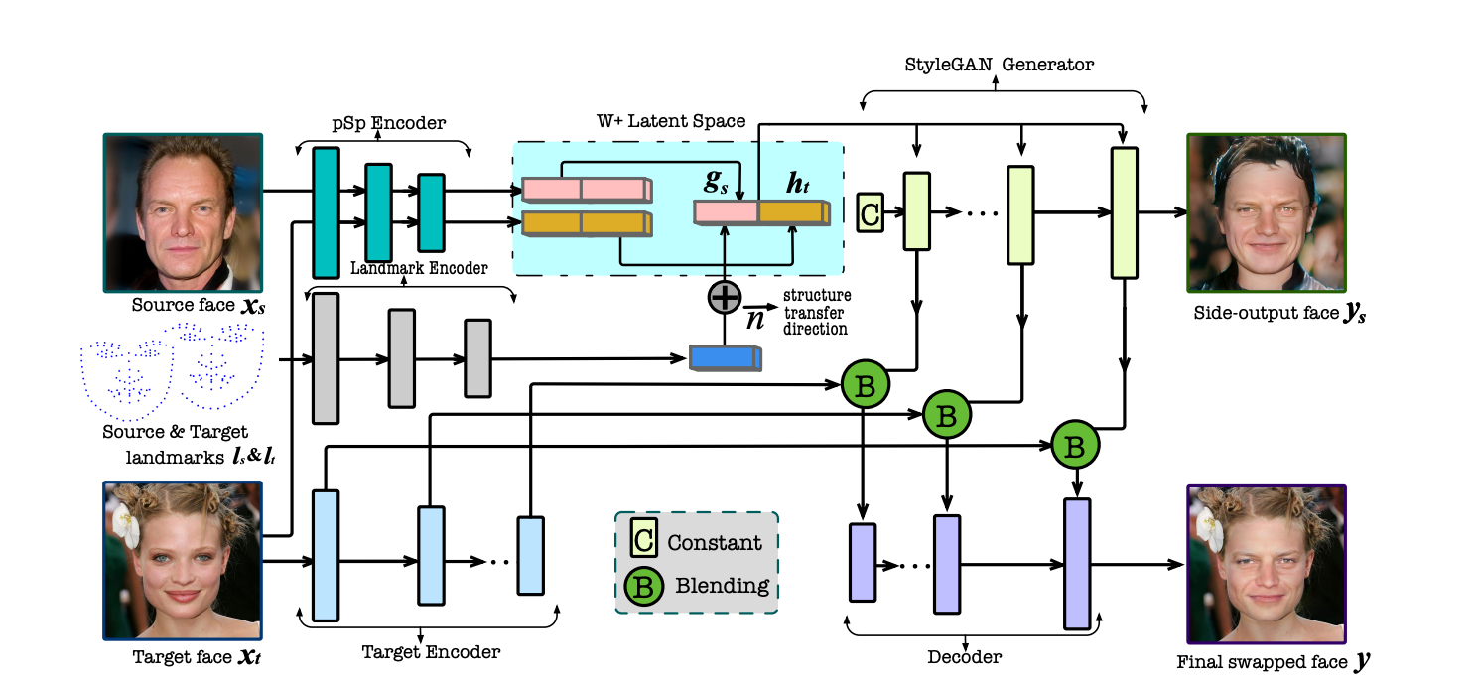
AttFace: High-resolution Face Swapping with Attention Network (TCI)
Background Transfer
To eliminate the blending boundary, target features are aggregated with the generative features in a multi-scale manner.
Blender Module
Notes:
replacing the components of f i t for the inner-face region with their counterparts

